Slide 1
CSDS 451: Designing High Performant Systems for AI
Lecture 6
9/11/2025
Sanmukh Kuppannagari
sanmukh.kuppannagari@case.edu
https://sanmukh.research.st/
Case Western Reserve University

Slide 2
Outline
Data Parallel Programming
Data Parallel Programming Approaches
Parallel Program Analysis

Slide 3
Outline
Data Parallel Programming
Data Parallel Programming Approaches
Parallel Program Analysis

Slide 4



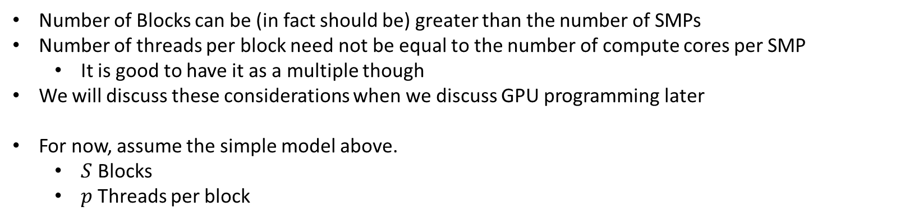



Modeling GPU Architectures
DRAM
$$0$$
$$1$$
$$S−1$$
C
C
C
0
1
$$p−1$$
0
1
$$p−1$$
0
1
$$p−1$$
Number of Blocks can be (in fact should be) greater than the number of SMPs
Number of threads per block need not be equal to the number of compute cores per SMP
It is good to have it as a multiple though
We will discuss these considerations when we discuss GPU programming later
For now, assume the simple model above.
$S$ Blocks
$p$ Threads per block

Slide 5
GPU Model
Think in terms of what each block computes, and what each thread within a block computes
Each thread on the GPU executes the same instructions on different data
We need to rethink our algorithms in terms of the above
Think Data Parallel

Slide 6
Data Parallelism
Key Idea:
Partition data into chunks –> Each chunk should require similar amount of work
Assign tasks to each partition so that they can proceed concurrently
Note: data parallelism doesn’t mean each task “need” to perform exact same computations
Usually it is true
SPMD (Single Program Multiple Data) is a special case of data parallelism where same “program” is run on different data

Slide 7
Data Parallelism - Approaches
#1 Partition Output data
Each task is responsible for computing an output partition
Output

Slide 8
Data Parallelism - Approaches
#1 Partition Output data
Each task is responsible for computing an output partition
Output

Slide 9



Data Parallelism - Approaches
#1 Partition Output data
Each task is responsible for computing an output partition
Output
$$P_{0}$$
$$P_{1}$$
$$P_{p−1}$$

Slide 10
Data Parallelism - Approaches
#1 Partition Output data
Useful when partitions of output can be computed independently of each other
Example: Blocked Matrix Multiplication
Output
$$P_{0}$$
$$P_{1}$$
$$P_{p−1}$$

Slide 11



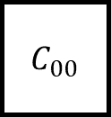
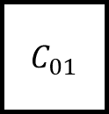



Data Parallelism – Approaches
#1 Partition Output data
Matrix Multiplication
$C_{00}$
$$A_{0:}$$
$C_{01}$
$$A_{0:}$$
$$B_{:0}$$
$$B_{:1}$$
Input data maybe shared
Output data distinct
$$P_{0}$$
$$P_{1}$$

Slide 12

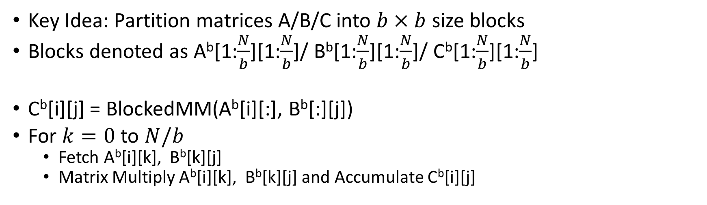


Block Matrix Multiplication
Key Idea: Partition matrices A/B/C into $b×b$ size blocks
Blocks denoted as A^{b}[1:$\frac{N}{b}$][1:$\frac{N}{b}$]/ B^{b}[1:$\frac{N}{b}$][1:$\frac{N}{b}$]/ C^{b}[1:$\frac{N}{b}$][1:$\frac{N}{b}$]
C^{b}[i][j] = BlockedMM(A^{b}[i][:], B^{b}[:][j])
For $k=0$ to $N/b$
Fetch A^{b}[i][k], B^{b}[k][j]
Matrix Multiply A^{b}[i][k], B^{b}[k][j] and Accumulate C^{b}[i][j]
$B^{b}[$:,j]
$A^{b}[$i,:]
$C^{b}[$i,j]

Slide 13


Block Matrix Multiplication
$B^{b}[$:,j]
Perform Matrix Multiplication of these two blocks
$A^{b}[$i,:]
$C^{b}[$i,j]

Slide 14
Block Matrix Multiplication
$B^{b}[$:,j]
Perform Matrix Multiplication of these two blocks
$A^{b}[$i,:]
$C^{b}[$i,j]

Slide 15
Block Matrix Multiplication
$B^{b}[$:,j]
Perform Matrix Multiplication of these two blocks
$A^{b}[$i,:]
$C^{b}[$i,j]

Slide 16
Block Matrix Multiplication
$B^{b}[$:,j]
Perform Matrix Multiplication of these two blocks
$A^{b}[$i,:]
$C^{b}[$i,j]

Slide 17
Modeling GPU Architectures
DRAM
$$0$$
$$1$$
$$S−1$$
C
C
C
0
1
$$p−1$$
0
1
$$p−1$$
0
1
$$p−1$$
$S$ Blocks (I will call them SMPs in the next few slides to avoid confusion with Blocks of matrices)
$p$ Threads per block

Slide 18
Block Matrix Multiplication
What is a natural way to split the computations of Matrix Multiplication to the SMPs of GPUs?

Slide 19
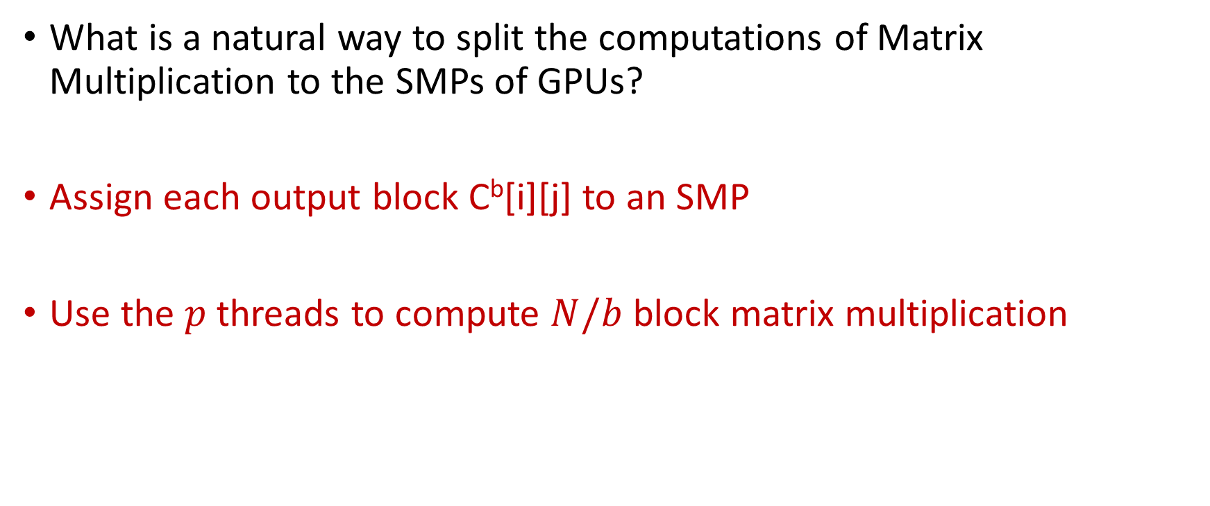
Block Matrix Multiplication
What is a natural way to split the computations of Matrix Multiplication to the SMPs of GPUs?
Assign each output block C^{b}[i][j] to an SMP
Use the $p$ threads to compute $N/b$ block matrix multiplication

Slide 20

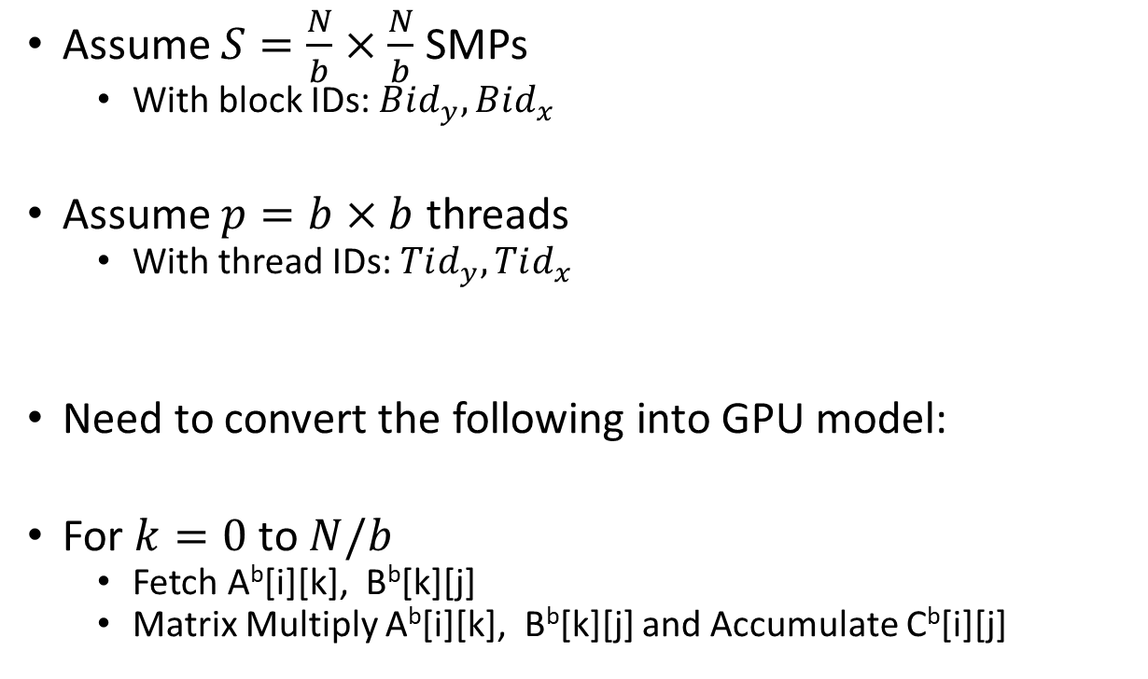



Block Matrix Multiplication
$$Bid_{x}$$
$$Bid_{y}$$
Assume $S=\frac{N}{b}×\frac{N}{b}$ SMPs
With block IDs: $Bid_{y}, Bid_{x}$
Assume $p=b×b$ threads
With thread IDs: $Tid_{y}, Tid_{x}$
Need to convert the following into GPU model:
For $k=0$ to $N/b$
Fetch A^{b}[i][k], B^{b}[k][j]
Matrix Multiply A^{b}[i][k], B^{b}[k][j] and Accumulate C^{b}[i][j]
$$Tid_{x}$$
$$Tid_{y}$$

Slide 21

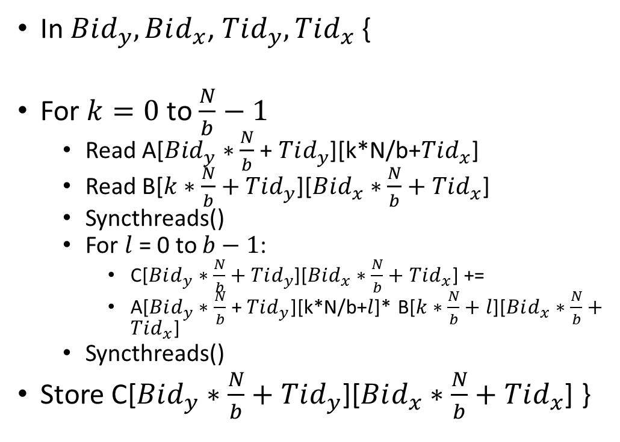
Block Matrix Multiplication
B
In $Bid_{y}, Bid_{x}$, $Tid_{y}, Tid_{x}$ {
For $k=0$ to $\frac{N}{b}−1$
Read A[$Bid_{y}∗\frac{N}{b}$ + $Tid_{y}$][k*N/b+$Tid_{x}$]
Read B[$k∗\frac{N}{b}+Tid_{y}$][$Bid_{x}∗\frac{N}{b}+Tid_{x}$]
Syncthreads()
For $l$ = 0 to $b−1$:
C[$Bid_{y}∗\frac{N}{b}+Tid_{y}$][$Bid_{x}∗\frac{N}{b}+Tid_{x}$] +=
A[$Bid_{y}∗\frac{N}{b}$ + $Tid_{y}$][k*N/b+$l$]* B[$k∗\frac{N}{b}+l$][$Bid_{x}∗\frac{N}{b}+Tid_{x}$]
Syncthreads()
Store C[$Bid_{y}∗\frac{N}{b}+Tid_{y}$][$Bid_{x}∗\frac{N}{b}+Tid_{x}$] }
A
C
SMP $Bid_{y},Bid_{x}$ produces the output block $Bid_{y},Bid_{x}$

Slide 22

Block Matrix Multiplication
B
What are the elements of $C$ that will be output by SMP $Bid_{y}, Bid_{x}$?
A
C
SMP $Bid_{y},Bid_{x}$ produces the output block $Bid_{y},Bid_{x}$

Slide 23
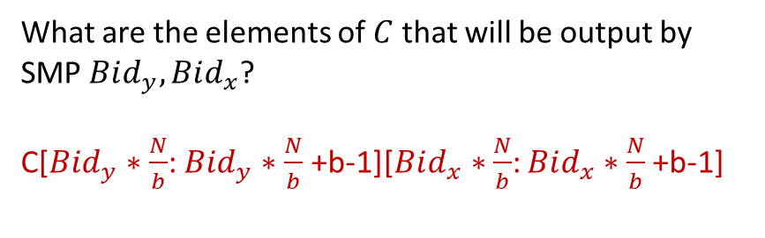
Block Matrix Multiplication
B
What are the elements of $C$ that will be output by SMP $Bid_{y}, Bid_{x}$?
C[$Bid_{y}∗\frac{N}{b}$: $Bid_{y}∗\frac{N}{b}$ +b-1][$Bid_{x}∗\frac{N}{b}$: $Bid_{x}∗\frac{N}{b}$+b-1]
A
C
SMP $Bid_{y},Bid_{x}$ produces the output block $Bid_{y},Bid_{x}$

Slide 24
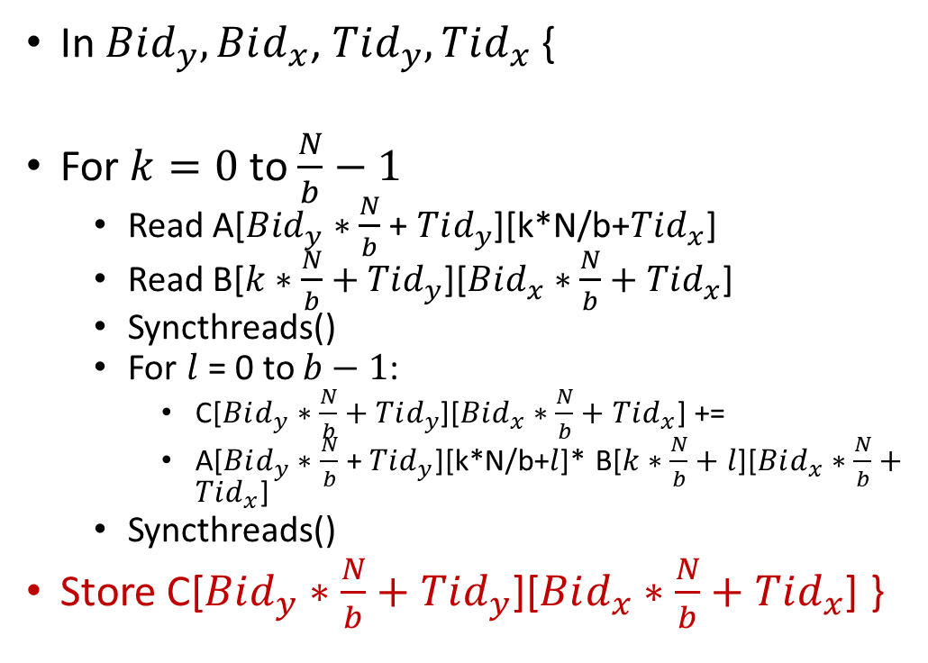
Block Matrix Multiplication
In $Bid_{y}, Bid_{x}$, $Tid_{y}, Tid_{x}$ {
For $k=0$ to $\frac{N}{b}−1$
Read A[$Bid_{y}∗\frac{N}{b}$ + $Tid_{y}$][k*N/b+$Tid_{x}$]
Read B[$k∗\frac{N}{b}+Tid_{y}$][$Bid_{x}∗\frac{N}{b}+Tid_{x}$]
Syncthreads()
For $l$ = 0 to $b−1$:
C[$Bid_{y}∗\frac{N}{b}+Tid_{y}$][$Bid_{x}∗\frac{N}{b}+Tid_{x}$] +=
A[$Bid_{y}∗\frac{N}{b}$ + $Tid_{y}$][k*N/b+$l$]* B[$k∗\frac{N}{b}+l$][$Bid_{x}∗\frac{N}{b}+Tid_{x}$]
Syncthreads()
Store C[$Bid_{y}∗\frac{N}{b}+Tid_{y}$][$Bid_{x}∗\frac{N}{b}+Tid_{x}$] }
Looking at the store instruction of this code, can you explain how this is happening?

Slide 25
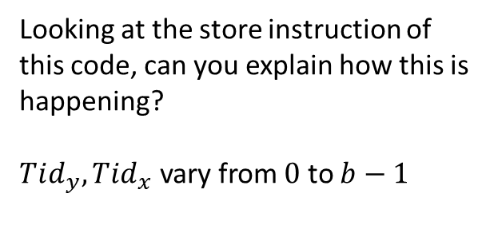
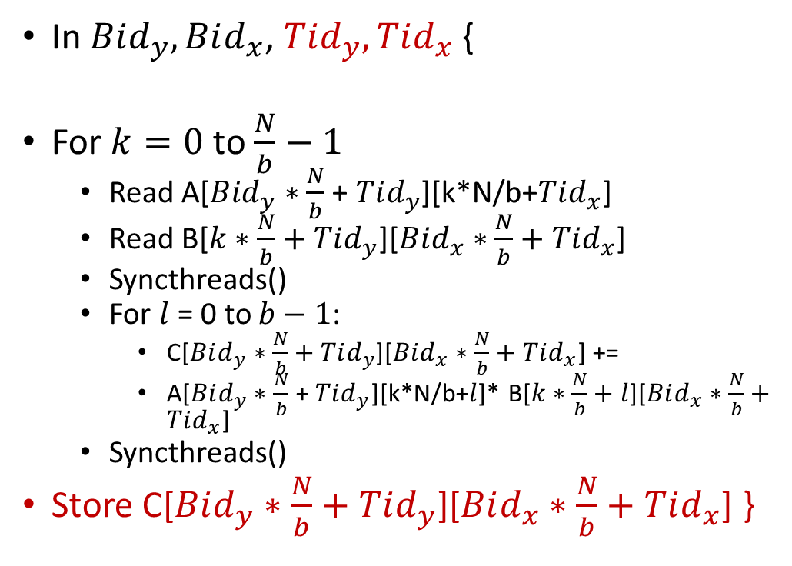
Block Matrix Multiplication
In $Bid_{y}, Bid_{x}$, $Tid_{y}, Tid_{x}$ {
For $k=0$ to $\frac{N}{b}−1$
Read A[$Bid_{y}∗\frac{N}{b}$ + $Tid_{y}$][k*N/b+$Tid_{x}$]
Read B[$k∗\frac{N}{b}+Tid_{y}$][$Bid_{x}∗\frac{N}{b}+Tid_{x}$]
Syncthreads()
For $l$ = 0 to $b−1$:
C[$Bid_{y}∗\frac{N}{b}+Tid_{y}$][$Bid_{x}∗\frac{N}{b}+Tid_{x}$] +=
A[$Bid_{y}∗\frac{N}{b}$ + $Tid_{y}$][k*N/b+$l$]* B[$k∗\frac{N}{b}+l$][$Bid_{x}∗\frac{N}{b}+Tid_{x}$]
Syncthreads()
Store C[$Bid_{y}∗\frac{N}{b}+Tid_{y}$][$Bid_{x}∗\frac{N}{b}+Tid_{x}$] }
Looking at the store instruction of this code, can you explain how this is happening?
$Tid_{y}, Tid_{x}$ vary from $0$ to $b−1$

Slide 26
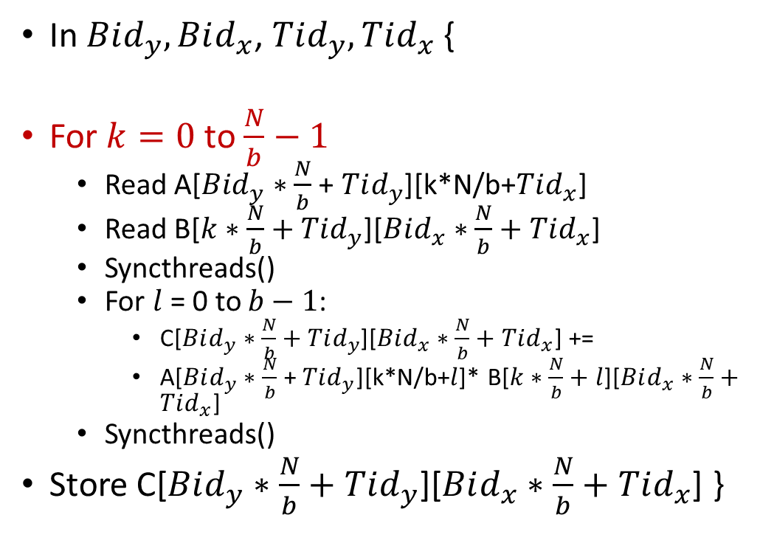
Block Matrix Multiplication
In $Bid_{y}, Bid_{x}$, $Tid_{y}, Tid_{x}$ {
For $k=0$ to $\frac{N}{b}−1$
Read A[$Bid_{y}∗\frac{N}{b}$ + $Tid_{y}$][k*N/b+$Tid_{x}$]
Read B[$k∗\frac{N}{b}+Tid_{y}$][$Bid_{x}∗\frac{N}{b}+Tid_{x}$]
Syncthreads()
For $l$ = 0 to $b−1$:
C[$Bid_{y}∗\frac{N}{b}+Tid_{y}$][$Bid_{x}∗\frac{N}{b}+Tid_{x}$] +=
A[$Bid_{y}∗\frac{N}{b}$ + $Tid_{y}$][k*N/b+$l$]* B[$k∗\frac{N}{b}+l$][$Bid_{x}∗\frac{N}{b}+Tid_{x}$]
Syncthreads()
Store C[$Bid_{y}∗\frac{N}{b}+Tid_{y}$][$Bid_{x}∗\frac{N}{b}+Tid_{x}$] }
We go block by block as before.

Slide 27
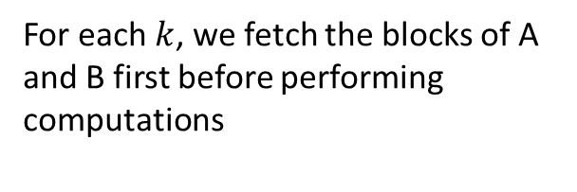
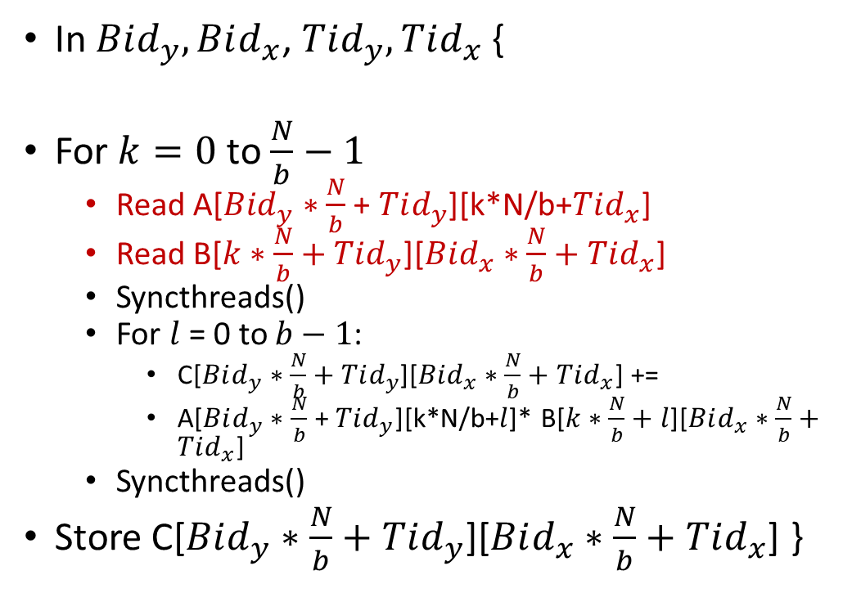
Block Matrix Multiplication
In $Bid_{y}, Bid_{x}$, $Tid_{y}, Tid_{x}$ {
For $k=0$ to $\frac{N}{b}−1$
Read A[$Bid_{y}∗\frac{N}{b}$ + $Tid_{y}$][k*N/b+$Tid_{x}$]
Read B[$k∗\frac{N}{b}+Tid_{y}$][$Bid_{x}∗\frac{N}{b}+Tid_{x}$]
Syncthreads()
For $l$ = 0 to $b−1$:
C[$Bid_{y}∗\frac{N}{b}+Tid_{y}$][$Bid_{x}∗\frac{N}{b}+Tid_{x}$] +=
A[$Bid_{y}∗\frac{N}{b}$ + $Tid_{y}$][k*N/b+$l$]* B[$k∗\frac{N}{b}+l$][$Bid_{x}∗\frac{N}{b}+Tid_{x}$]
Syncthreads()
Store C[$Bid_{y}∗\frac{N}{b}+Tid_{y}$][$Bid_{x}∗\frac{N}{b}+Tid_{x}$] }
For each $k$, we fetch the blocks of A and B first before performing computations

Slide 28
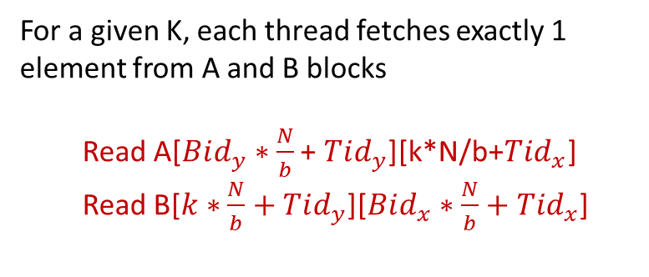

Block Matrix Multiplication
For a given K, each thread fetches exactly 1 element from A and B blocks
Read A[$Bid_{y}∗\frac{N}{b}$ + $Tid_{y}$][k*N/b+$Tid_{x}$]
Read B[$k∗\frac{N}{b}+Tid_{y}$][$Bid_{x}∗\frac{N}{b}+Tid_{x}$]
$$k=2$$
Number of elements in a block?

Slide 29
Block Matrix Multiplication
For a given K, each thread fetches exactly 1 element from A and B blocks
Read A[$Bid_{y}∗\frac{N}{b}$ + $Tid_{y}$][k*N/b+$Tid_{x}$]
Read B[$k∗\frac{N}{b}+Tid_{y}$][$Bid_{x}∗\frac{N}{b}+Tid_{x}$]
$$k=2$$
Number of elements in a block? $b×b$

Slide 30
Block Matrix Multiplication
For a given K, each thread fetches exactly 1 element from A and B blocks
Read A[$Bid_{y}∗\frac{N}{b}$ + $Tid_{y}$][k*N/b+$Tid_{x}$]
Read B[$k∗\frac{N}{b}+Tid_{y}$][$Bid_{x}∗\frac{N}{b}+Tid_{x}$]
$$k=2$$
Number of threads in a block?

Slide 31
Block Matrix Multiplication
For a given K, each thread fetches exactly 1 element from A and B blocks
Read A[$Bid_{y}∗\frac{N}{b}$ + $Tid_{y}$][k*N/b+$Tid_{x}$]
Read B[$k∗\frac{N}{b}+Tid_{y}$][$Bid_{x}∗\frac{N}{b}+Tid_{x}$]
$$k=2$$
Number of threads in a block? $b×b$

Slide 32
Block Matrix Multiplication
For a given K, each thread fetches exactly 1 element from A and B blocks
Read A[$Bid_{y}∗\frac{N}{b}$ + $Tid_{y}$][k*N/b+$Tid_{x}$]
Read B[$k∗\frac{N}{b}+Tid_{y}$][$Bid_{x}∗\frac{N}{b}+Tid_{x}$]
$$k=2$$
Which thread fetches $Tid_{y}, Tid_{x}$ element of A (or B)?

Slide 33

Block Matrix Multiplication
For a given K, each thread fetches exactly 1 element from A and B blocks
Read A[$Bid_{y}∗\frac{N}{b}$ + $Tid_{y}$][k*N/b+$Tid_{x}$]
Read B[$k∗\frac{N}{b}+Tid_{y}$][$Bid_{x}∗\frac{N}{b}+Tid_{x}$]
$$k=2$$
Which thread fetches $Tid_{y}, Tid_{x}$ element of A (or B)? $Tid_{y}, Tid_{x}$
This is prefetching. Note that the item fetched by $Tid_{y}, Tid_{x}$ will be used by multiple threads. Can you identify the range of threads that will use it? (I may ask such questions in the exam)

Slide 34
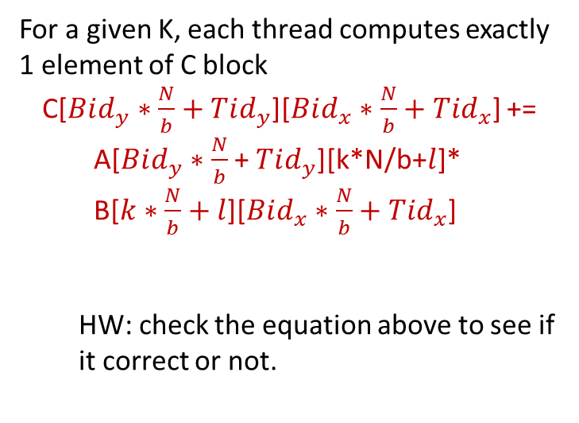
Block Matrix Multiplication
B
For a given K, each thread computes exactly 1 element of C block
C[$Bid_{y}∗\frac{N}{b}+Tid_{y}$][$Bid_{x}∗\frac{N}{b}+Tid_{x}$] +=
A[$Bid_{y}∗\frac{N}{b}$ + $Tid_{y}$][k*N/b+$l$]*
B[$k∗\frac{N}{b}+l$][$Bid_{x}∗\frac{N}{b}+Tid_{x}$]
HW: check the equation above to see if it correct or not.
A
C
SMP $Bid_{y},Bid_{x}$ produces the output block $Bid_{y},Bid_{x}$

Slide 35
Data Parallelism – Approaches
#1 Partition Output data
Notice how we thought about how to divide the output that is being produced among the parallel blocks and threads?
Notice how there are no write conflicts and each block can execute independently?
Threads can too for the most part, but need synchronization steps in between.
This approach, if applicable, leads to the best parallelism on GPUs

Slide 36
Data Parallelism - Approaches
#2 Partition Input data
Each task is responsible for performing “all” operations on the partition
Input

Slide 37
Data Parallelism - Approaches
#2 Partition Input data
Each task is responsible for performing “all” operations on the partition
Input

Slide 38
Data Parallelism - Approaches
#2 Partition Input data
Each task is responsible for performing “all” operations on the partition
Input
$$P_{0}$$
$$P_{1}$$
$$P_{p−1}$$

Slide 39
Data Parallelism - Approaches
#2 Partition Input data
Tasks can either directly produce the final output
Or produce intermediate output which require another set of tasks to produce the final output
Input
$$P_{0}$$
$$P_{1}$$
$$P_{p−1}$$

Slide 40
Data Parallelism - Approaches
#2 Partition Input data
Suitable when outputs cannot be independently computed
Example: Aggregation functions, Hashing, …
Input
$$P_{0}$$
$$P_{1}$$
$$P_{p−1}$$

Slide 41
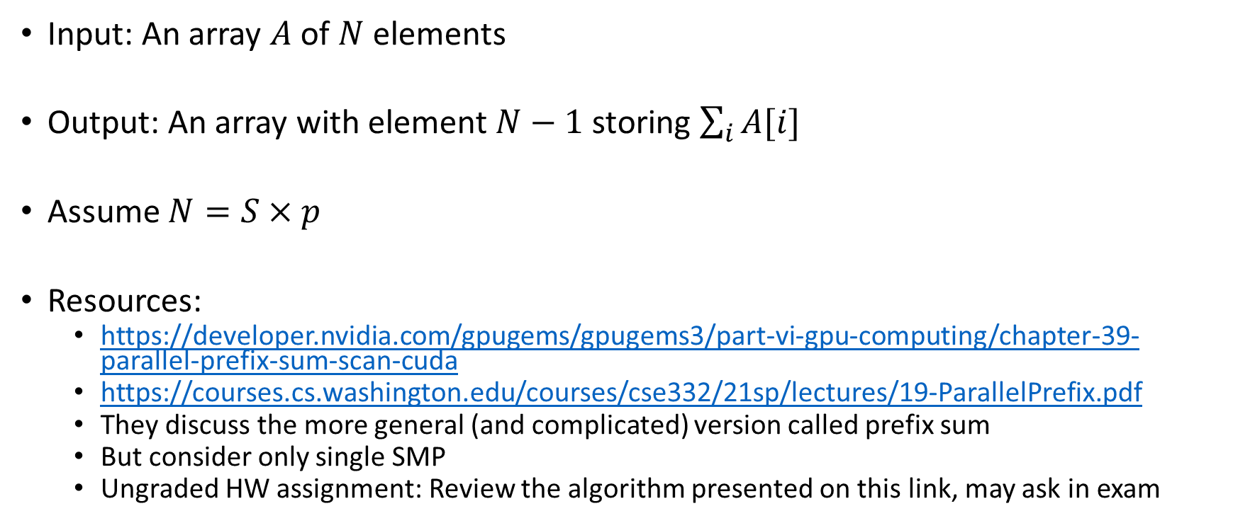
Sum of Elements in an Array
Input: An array $A$ of $N$ elements
Output: An array with element $N−1$ storing $\sum_{i}{A[i]}$
Assume $N=S×p$
Resources:
https://developer.nvidia.com/gpugems/gpugems3/part-vi-gpu-computing/chapter-39-parallel-prefix-sum-scan-cuda
https://courses.cs.washington.edu/courses/cse332/21sp/lectures/19-ParallelPrefix.pdf
They discuss the more general (and complicated) version called prefix sum
But consider only single SMP
Ungraded HW assignment: Review the algorithm presented on this link, may ask in exam

Slide 42
Sum of Array
Input: [1, 3, 5, 7, 9]
Output: [x, x, x, x, 25]

Slide 43

Sum of Array
Key Idea:
Tree like computation to achieve independent computations
Two phase algorithm, 1 within a SMP and 1 across SMPs
$$S×p$$
C
C
C

Slide 44
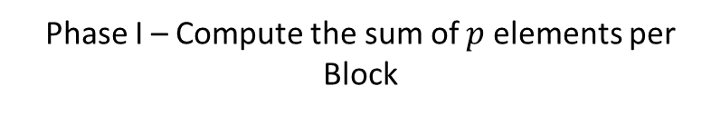
Sum of Array
Key Idea:
Tree like computation to achieve independent computations
Two phase algorithm, 1 within a SMP and 1 across SMPs
$$S×p$$
C
C
C
Phase I – Compute the sum of $p$ elements per Block

Slide 45
Sum of Array
Key Idea:
Tree like computation to achieve independent computations
Two phase algorithm, 1 within a SMP and 1 across SMPs
$$S×p$$
C
C
C
How many sums will remain after Phase I?

Slide 46

Sum of Array
Key Idea:
Tree like computation to achieve independent computations
Two phase algorithm, 1 within a SMP and 1 across SMPs
$$S×p$$
C
C
C
How many sums will remain after Phase I? $S$

Slide 47
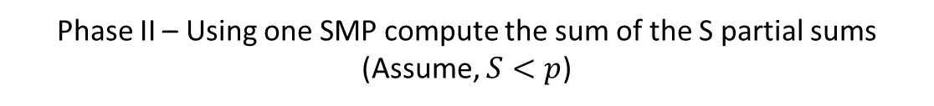
Sum of Array
Key Idea:
Tree like computation to achieve independent computations
Two phase algorithm, 1 within a SMP and 1 across SMPs
$$S×p$$
C
Phase II – Using one SMP compute the sum of the S partial sums
(Assume, $S<p$)

Slide 48

Sum of Array
Phase I: Calculate the sum of $p$ elements and store into the last location of the array
Use $p$ processors
Recursive Doubling Algorithm

Slide 49













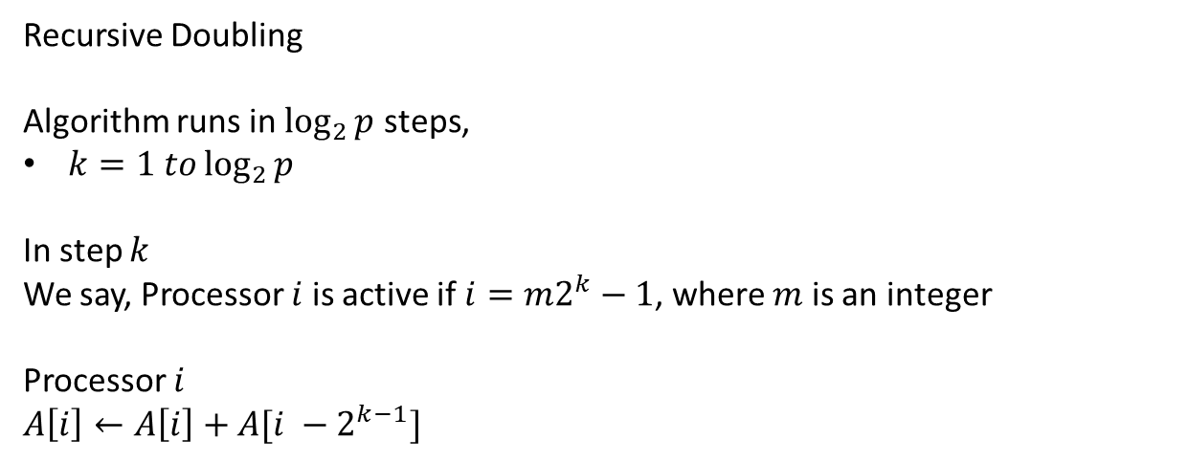



Sum of Array
Data Array
$$1$$
$$2$$
$$3$$
$$4$$
$$5$$
$$6$$
$$7$$
$$8$$
Processors
$$P_{0}$$
$$P_{1}$$
$$P_{2}$$
$$P_{3}$$
$$P_{4}$$
$$P_{5}$$
$$P_{6}$$
$$P_{7}$$
Recursive Doubling
Algorithm runs in $\log_{2}{p}$ steps,
$k=1 to\log_{2}{p}$
In step $k$
We say, Processor $i$ is active if $i={m2}^{k}−1$, where $m$ is an integer
Processor $i$
$A\left[i\right]←A\left[i\right]+A[i −2^{k−1}]$

Slide 50
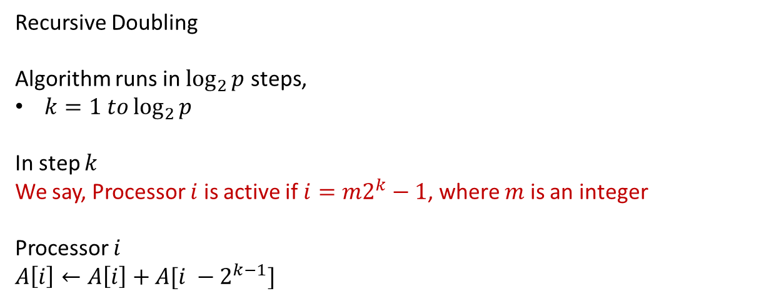

Sum of Array
Data Array
$$1$$
$$2$$
$$3$$
$$4$$
$$5$$
$$6$$
$$7$$
$$8$$
Processors
$$P_{0}$$
$$P_{1}$$
$$P_{2}$$
$$P_{3}$$
$$P_{4}$$
$$P_{5}$$
$$P_{6}$$
$$P_{7}$$
Step 1: $k=1$ Active Processors??
Recursive Doubling
Algorithm runs in $\log_{2}{p}$ steps,
$k=1 to\log_{2}{p}$
In step $k$
We say, Processor $i$ is active if $i={m2}^{k}−1$, where $m$ is an integer
Processor $i$
$A\left[i\right]←A\left[i\right]+A[i −2^{k−1}]$

Slide 51





Sum of Array
Data Array
$$1$$
$$2$$
$$3$$
$$4$$
$$5$$
$$6$$
$$7$$
$$8$$
Processors
$$P_{0}$$
$$P_{1}$$
$$P_{2}$$
$$P_{3}$$
$$P_{4}$$
$$P_{5}$$
$$P_{6}$$
$$P_{7}$$
Step 1: $k=1$ Active Processors?? 1, 3, 5, 7
Recursive Doubling
Algorithm runs in $\log_{2}{p}$ steps,
$k=1 to\log_{2}{p}$
In step $k$
We say, Processor $i$ is active if $i={m2}^{k}−1$, where $m$ is an integer
Processor $i$
$A\left[i\right]←A\left[i\right]+A[i −2^{k−1}]$

Slide 52
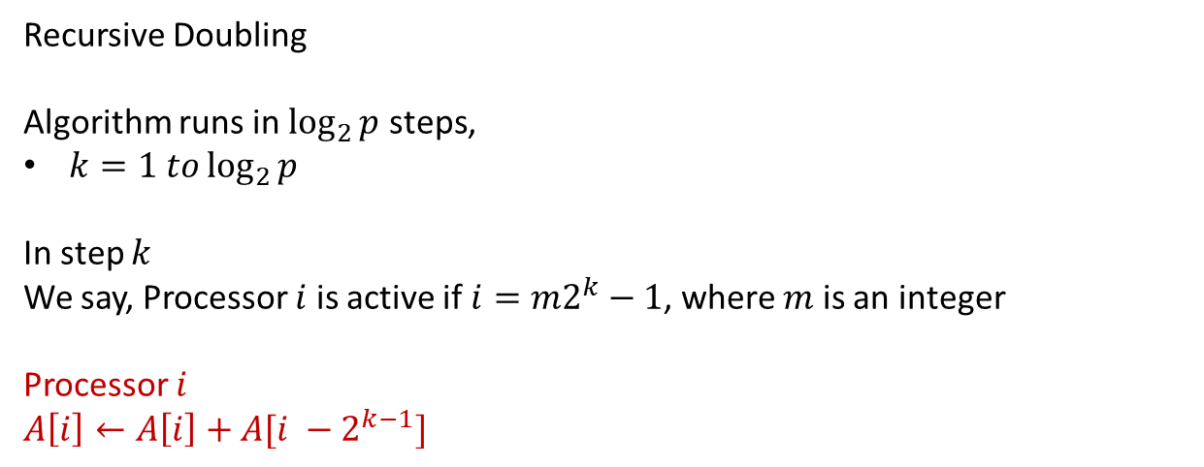

Sum of Array
Data Array
$$1$$
$$2$$
$$3$$
$$4$$
$$5$$
$$6$$
$$7$$
$$8$$
Processors
$$P_{0}$$
$$P_{1}$$
$$P_{2}$$
$$P_{3}$$
$$P_{4}$$
$$P_{5}$$
$$P_{6}$$
$$P_{7}$$
Step 1: $k=1$ Result of Computation?
Recursive Doubling
Algorithm runs in $\log_{2}{p}$ steps,
$k=1 to\log_{2}{p}$
In step $k$
We say, Processor $i$ is active if $i={m2}^{k}−1$, where $m$ is an integer
Processor $i$
$A\left[i\right]←A\left[i\right]+A[i −2^{k−1}]$

Slide 53




Sum of Array
Data Array
$$1$$
$$3$$
$$3$$
$$7$$
$$5$$
$$11$$
$$7$$
$$15$$
Processors
$$P_{0}$$
$$P_{1}$$
$$P_{2}$$
$$P_{3}$$
$$P_{4}$$
$$P_{5}$$
$$P_{6}$$
$$P_{7}$$
Step 1: $k=1$ Result of Computation?
Recursive Doubling
Algorithm runs in $\log_{2}{p}$ steps,
$k=1 to\log_{2}{p}$
In step $k$
We say, Processor $i$ is active if $i={m2}^{k}−1$, where $m$ is an integer
Processor $i$
$A\left[i\right]←A\left[i\right]+A[i −2^{k−1}]$

Slide 54





Sum of Array
Data Array
$$1$$
$$3$$
$$3$$
$$7$$
$$5$$
$$11$$
$$7$$
$$15$$
Processors
$$P_{0}$$
$$P_{1}$$
$$P_{2}$$
$$P_{3}$$
$$P_{4}$$
$$P_{5}$$
$$P_{6}$$
$$P_{7}$$
Step 1: $k=2$ Active Processors??
Recursive Doubling
Algorithm runs in $\log_{2}{p}$ steps,
$k=1 to\log_{2}{p}$
In step $k$
We say, Processor $i$ is active if $i={m2}^{k}−1$, where $m$ is an integer
Processor $i$
$A\left[i\right]←A\left[i\right]+A[i −2^{k−1}]$

Slide 55

Sum of Array
Data Array
$$1$$
$$3$$
$$3$$
$$7$$
$$5$$
$$11$$
$$7$$
$$15$$
Processors
$$P_{0}$$
$$P_{1}$$
$$P_{2}$$
$$P_{3}$$
$$P_{4}$$
$$P_{5}$$
$$P_{6}$$
$$P_{7}$$
Step 1: $k=2$ Active Processors?? 3,7
Recursive Doubling
Algorithm runs in $\log_{2}{p}$ steps,
$k=1 to\log_{2}{p}$
In step $k$
We say, Processor $i$ is active if $i={m2}^{k}−1$, where $m$ is an integer
Processor $i$
$A\left[i\right]←A\left[i\right]+A[i −2^{k−1}]$

Slide 56

Sum of Array
Data Array
$$1$$
$$3$$
$$3$$
$$7$$
$$5$$
$$11$$
$$7$$
$$15$$
Processors
$$P_{0}$$
$$P_{1}$$
$$P_{2}$$
$$P_{3}$$
$$P_{4}$$
$$P_{5}$$
$$P_{6}$$
$$P_{7}$$
Step 1: $k=2$ Computations?
Recursive Doubling
Algorithm runs in $\log_{2}{p}$ steps,
$k=1 to\log_{2}{p}$
In step $k$
We say, Processor $i$ is active if $i={m2}^{k}−1$, where $m$ is an integer
Processor $i$
$A\left[i\right]←A\left[i\right]+A[i −2^{k−1}]$

Slide 57


Sum of Array
Data Array
$$1$$
$$3$$
$$3$$
$$10$$
$$5$$
$$11$$
$$7$$
$$26$$
Processors
$$P_{0}$$
$$P_{1}$$
$$P_{2}$$
$$P_{3}$$
$$P_{4}$$
$$P_{5}$$
$$P_{6}$$
$$P_{7}$$
Step 1: $k=2$ Computations?
Recursive Doubling
Algorithm runs in $\log_{2}{p}$ steps,
$k=1 to\log_{2}{p}$
In step $k$
We say, Processor $i$ is active if $i={m2}^{k}−1$, where $m$ is an integer
Processor $i$
$A\left[i\right]←A\left[i\right]+A[i −2^{k−1}]$

Slide 58



Sum of Array
Data Array
$$1$$
$$3$$
$$3$$
$$10$$
$$5$$
$$11$$
$$7$$
$$26$$
Processors
$$P_{0}$$
$$P_{1}$$
$$P_{2}$$
$$P_{3}$$
$$P_{4}$$
$$P_{5}$$
$$P_{6}$$
$$P_{7}$$
Step 1: $k=3$ Active Processors?
Recursive Doubling
Algorithm runs in $\log_{2}{p}$ steps,
$k=1 to\log_{2}{p}$
In step $k$
We say, Processor $i$ is active if $i={m2}^{k}−1$, where $m$ is an integer
Processor $i$
$A\left[i\right]←A\left[i\right]+A[i −2^{k−1}]$

Slide 59

Sum of Array
Data Array
$$1$$
$$3$$
$$3$$
$$10$$
$$5$$
$$11$$
$$7$$
$$26$$
Processors
$$P_{0}$$
$$P_{1}$$
$$P_{2}$$
$$P_{3}$$
$$P_{4}$$
$$P_{5}$$
$$P_{6}$$
$$P_{7}$$
Step 1: $k=3$ Active Processors? 7
Recursive Doubling
Algorithm runs in $\log_{2}{p}$ steps,
$k=1 to\log_{2}{p}$
In step $k$
We say, Processor $i$ is active if $i={m2}^{k}−1$, where $m$ is an integer
Processor $i$
$A\left[i\right]←A\left[i\right]+A[i −2^{k−1}]$

Slide 60

Sum of Array
Data Array
$$1$$
$$3$$
$$3$$
$$10$$
$$5$$
$$11$$
$$7$$
$$26$$
Processors
$$P_{0}$$
$$P_{1}$$
$$P_{2}$$
$$P_{3}$$
$$P_{4}$$
$$P_{5}$$
$$P_{6}$$
$$P_{7}$$
Step 1: $k=3$ Computations?
Recursive Doubling
Algorithm runs in $\log_{2}{p}$ steps,
$k=1 to\log_{2}{p}$
In step $k$
We say, Processor $i$ is active if $i={m2}^{k}−1$, where $m$ is an integer
Processor $i$
$A\left[i\right]←A\left[i\right]+A[i −2^{k−1}]$

Slide 61

Sum of Array
Data Array
$$1$$
$$3$$
$$3$$
$$10$$
$$5$$
$$11$$
$$7$$
$$36$$
Processors
$$P_{0}$$
$$P_{1}$$
$$P_{2}$$
$$P_{3}$$
$$P_{4}$$
$$P_{5}$$
$$P_{6}$$
$$P_{7}$$
Step 1: $k=3$ Computations?
Recursive Doubling
Algorithm runs in $\log_{2}{p}$ steps,
$k=1 to\log_{2}{p}$
In step $k$
We say, Processor $i$ is active if $i={m2}^{k}−1$, where $m$ is an integer
Processor $i$
$A\left[i\right]←A\left[i\right]+A[i −2^{k−1}]$

Slide 62
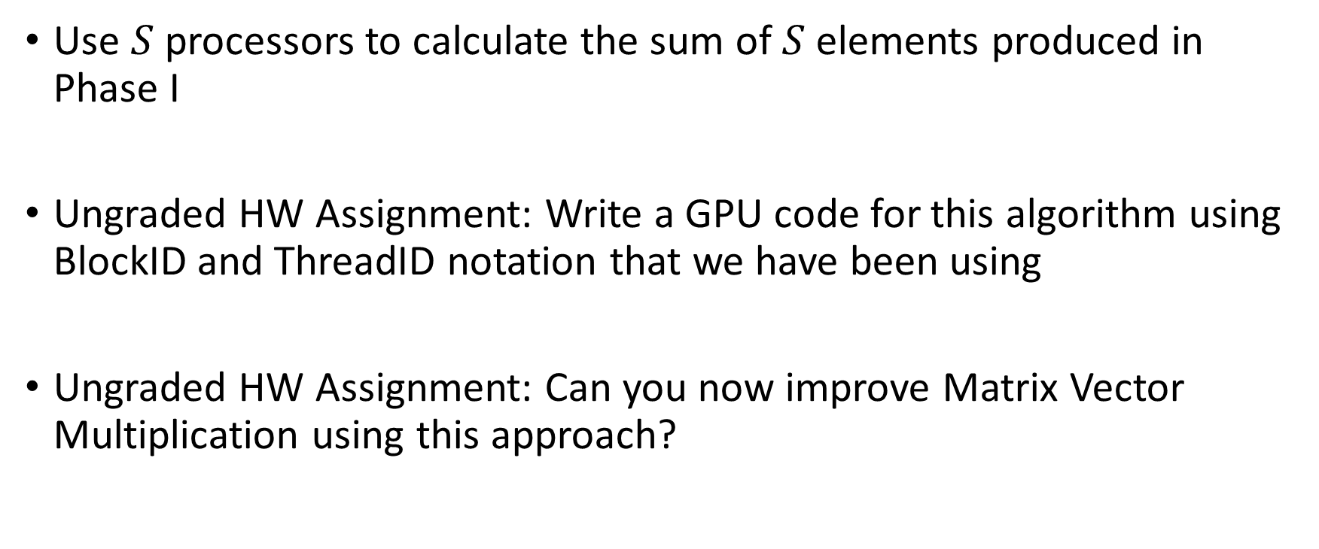
Sum of Array – Phase II
Use $S$ processors to calculate the sum of $S$ elements produced in Phase I
Ungraded HW Assignment: Write a GPU code for this algorithm using BlockID and ThreadID notation that we have been using
Ungraded HW Assignment: Can you now improve Matrix Vector Multiplication using this approach?

Slide 63
Data Parallelism – Hybrid Approaches
#3 Partition both Input and Output data
For each output partition, further partition the inputs
Blocked MM
Input blocks can be further assigned to different SMPs, achieving input parallelism in addition to output parallelism

Slide 64
Data Parallelism
We will discuss a couple more algorithms in the next class

Slide 65
Outline
Data Parallel Programming
Data Parallel Programming Approaches
Parallel Program Analysis

Slide 66
Techniques to Improve Application Performance
Compute Parallelization
Decompose tasks to enable concurrent processing
Memory Optimizations
Optimizations addressing latency
Optimizations targeted toward maximizing bandwidth utilization
Optimizations that reduce the amount of data transfer

Slide 67
But…
Before we dig into parallelizing an application, how do we know if it is worth parallelizing?
Performance Metrics discussed till now can reason about an algorithm as a whole
Cannot reason about what kinds of benefits we may get from parallelization
Cannot reason about the maximum benefit that can be obtained and if it is worth spending the effort on parallelization or not

Slide 68
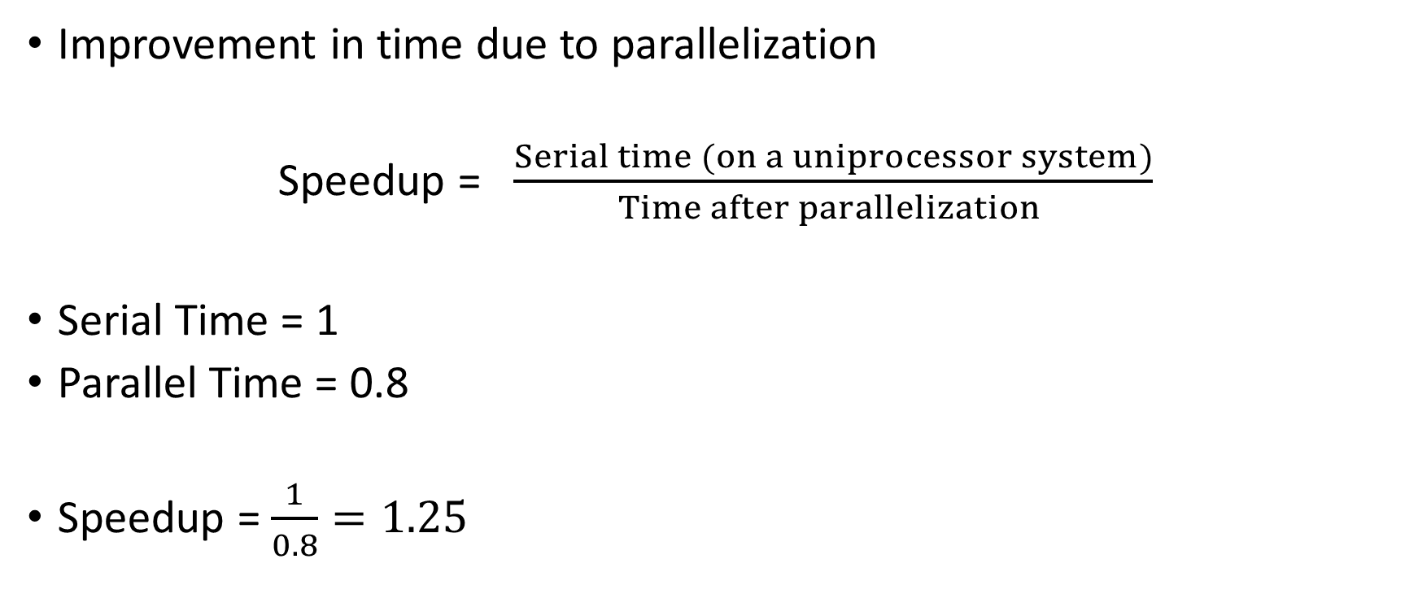
Speedup
Improvement in time due to parallelization
Speedup = $\frac{Serial time (on a uniprocessor system)}{Time after parallelization }$
Serial Time = 1
Parallel Time = 0.8
Speedup = $\frac{1}{0.8}=1.25$

Slide 69

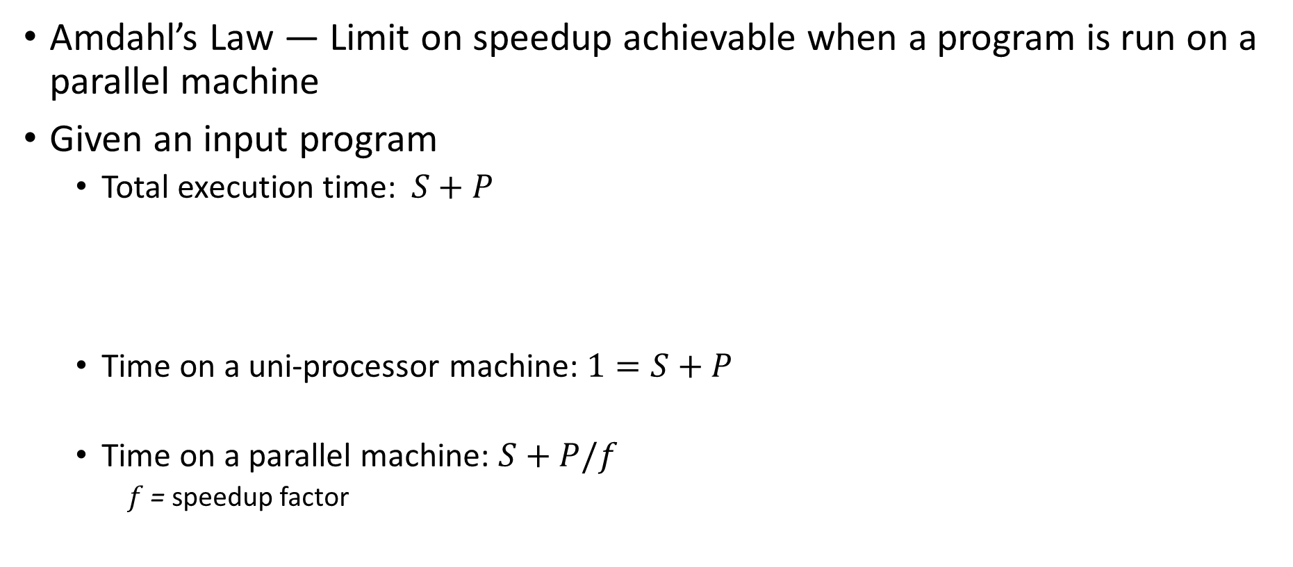

Amdahl’s Law
Amdahl’s Law — Limit on speedup achievable when a program is run on a parallel machine
Given an input program
Total execution time: $S+P$
Time on a uni-processor machine: $1=S+P$
Time on a parallel machine: $S+P/f$
$f$ = speedup factor
$$S$$
Serial Portion
Parallelizable Portion
$$P$$
1

Slide 70

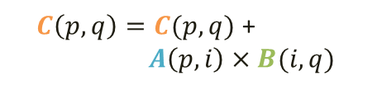





Amdahl’s Law
Serial Time
=
Parallel Time
$$S$$
$$S+P$$
$f=$ speedup factor
=
$$S+P/f$$
$$P$$
1
$$1$$
=
$$S+P/f$$
$$1$$
≤
$$S$$
If serial portion is 50 %, then the overall speedup ≤ 2
Note: Speedup factor ($f$) $≤$ # of processors

Slide 71





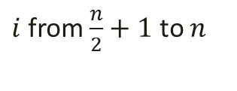
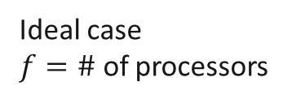
Amdahl’s Law
$$1$$
$$1$$
$$→\frac{1}{S}$$
Overall Speedup =
=
$$S+P/f$$
$$S+(1−S)/f$$
Ideal Overall
Speedup
Ideal case
$f=\#$ of processors
Number of Processors ($p$)

Slide 72


Scalability (1)
Does performance (execution time) improve as we use more resources (processors)
0
$$p−1$$
P
P
P
…
M
Memory
$p$ times faster?
Serial
Parallel

Slide 73
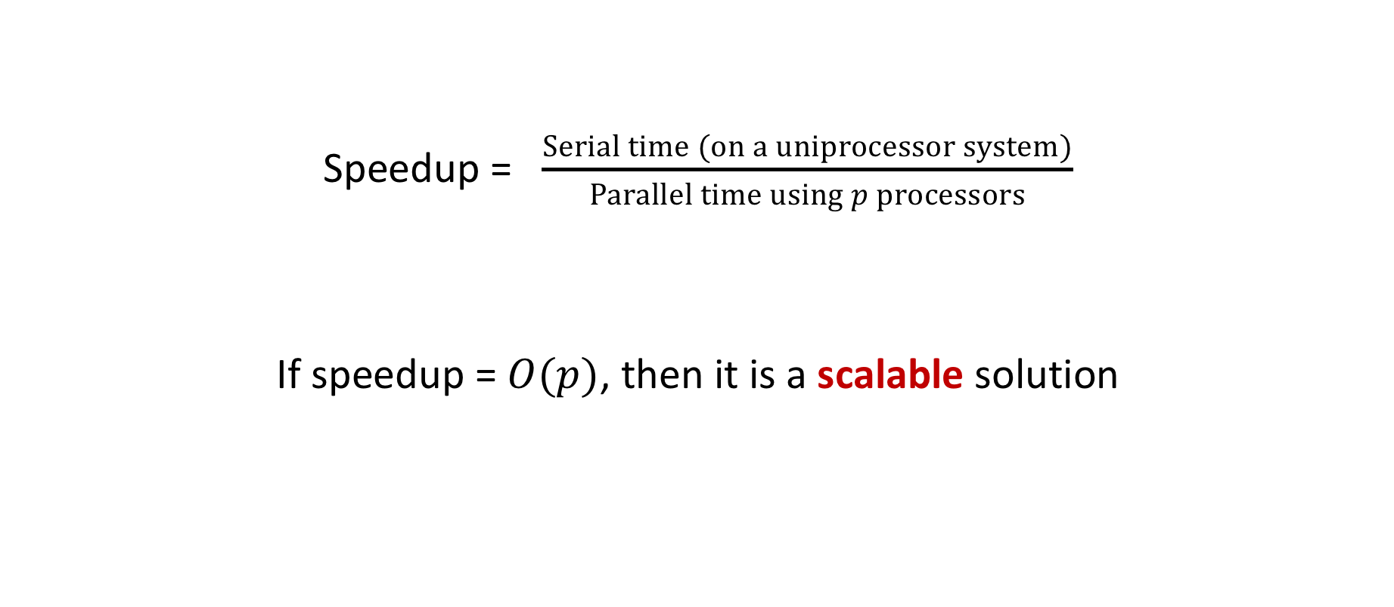
Scalability (2)
Speedup = $\frac{Serial time (on a uniprocessor system)}{Parallel time using p processors}$
If speedup = $O(p)$, then it is a scalable solution

Slide 74
Overheads in Parallel Computation
Communication
Synchronization
Load balance (processors may idle)
Resource contention

Slide 75
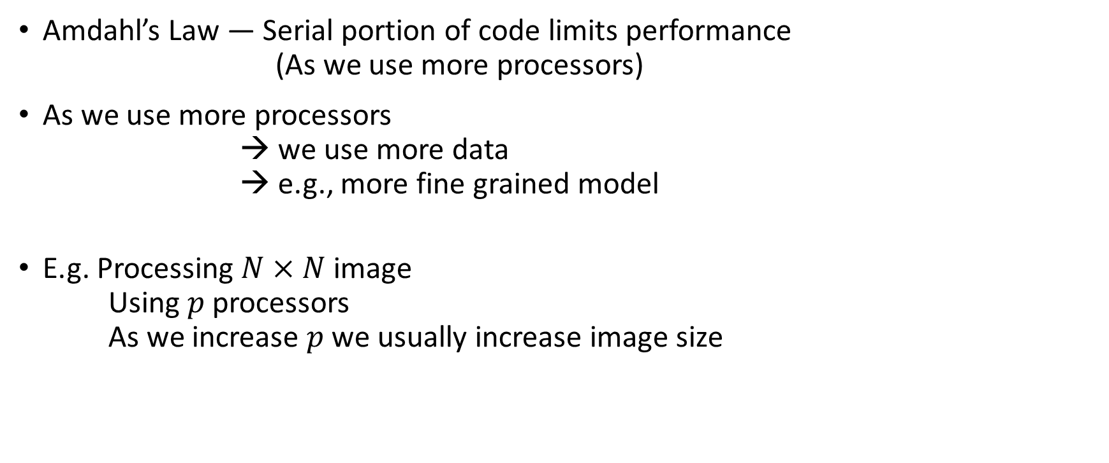
Scaled Speedup (Gustafson’s Law) (1)
Amdahl’s Law — Serial portion of code limits performance
(As we use more processors)
As we use more processors
we use more data
→ e.g., more fine grained model
E.g. Processing $N×N$image
Using $p$ processors
As we increase $p$we usually increase image size

Slide 76













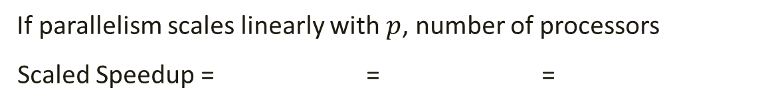
Scaled Speedup (Gustafson’s Law) (2)
Amdahl’s Law: Fixed amount of computations
$$1$$
Serial Time
$$S$$
$$1 – S$$
$$1 – S$$
Parallel Time
$$S$$
$p$: Number of Processors
$$p$$
Gustafson’s Law: Increase $p$ and amount of computations
1
Parallel Time
$$S′$$
$$P^{′}=1 – S′$$
Serial Time
$$S′$$
$$(1 – S′) p$$
If parallelism scales linearly with $p$, number of processors
Scaled Speedup = = =
Serial time
$$S′ + \left(1 – S′\right)p$$
$$S′ + \left(1 – S′\right)p$$
Parallel time
$$S′+P^{′}$$
1

Slide 77






Scaled Speedup (Gustafson’s Law) (3)
Gustafson’s Law
$$S′ + \left(1 – S′\right)p$$
Scaled Speedup $=$
$$≈ \left(1 – S′\right)p$$
$S^{′}=0.5 →$ Scaled Speedup $=$ Ideal speedup ($p$)
$S^{′}=0.5 → \text{Scaled} \text{Speedup}=0.5 p$, $50\%$of Ideal speedup
Example: ML Training
$$S^{′}$$
Setup Overhead
$$……$$
Parallel Training
Scaled Speedup $∝\left(1−S^{′}\right) ×$ # of threads

Slide 78
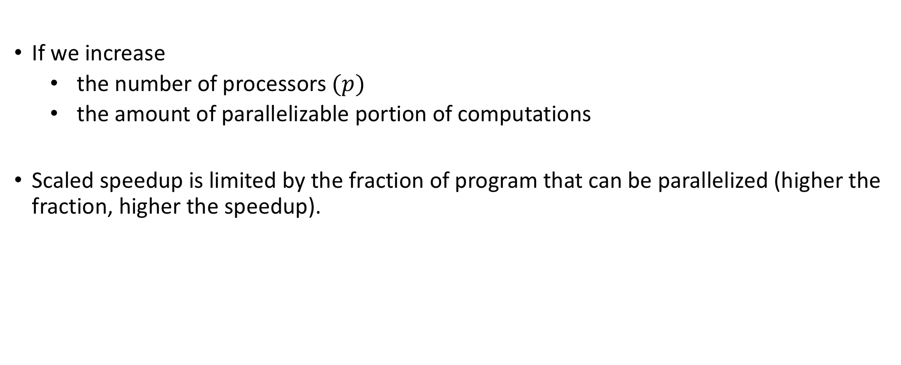
Scaled Speedup (Gustafson’s Law) (4)
Gustafson’s Law
If we increase
the number of processors $(p)$
the amount of parallelizable portion of computations
Scaled speedup is limited by the fraction of program that can be parallelized (higher the fraction, higher the speedup).

Slide 79

Scaled Speedup (Gustafson’s Law) (5)
$S=0.5$
$p=32$
Amdahl’s Law – Cannot achieve more than 2x speedup
Gustafson’s Law – Can achieve 16x speedup

Slide 80

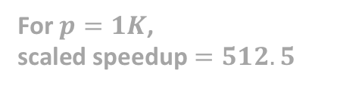
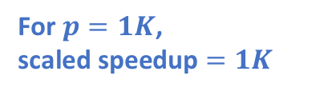
Scaled Speedup (Gustafson’s Law) (6)
For $p=1K$,
scaled speedup $=1K$
1024
Scaled
Speedup
512.5
For $p=1K$,
scaled speedup $=512.5$
Number of Processors ($p$)

Slide 81
Strong or Weak Scaling
Strong Scaling
Governed by Amdahl’s Law
The number of processors is increased while the problem size remains constant
Results in a reduced workload per processor
Weak Scaling
Governed by Gustafson’s Law
Both the number of processors and the problem size are increased
Results in a constant workload per processor
Notes:
https://hpc-wiki.info/hpc/Scaling_tests

Slide 82






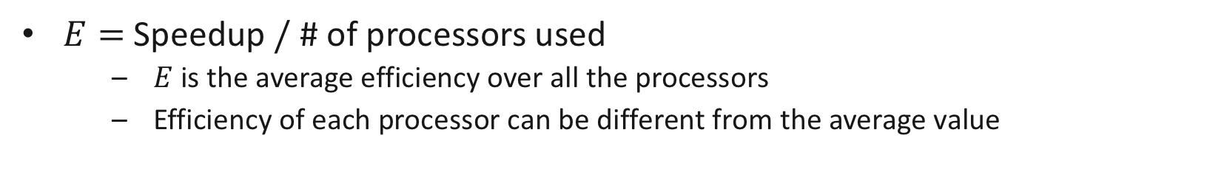
Performance (1)
Efficiency
Question: If we use $p$processors, is speedup = $p$?
Efficiency$=$Fraction of time a processor is usefully employed during the computation
Typical execution of a program on
a parallel machine
Serial time
$p$=1
Serial Computation
$$P_{1}$$
$p$=2
$$P_{2}$$
0.5
1
Time
useful work
$E=$Speedup$/$ # of processors used
$E$is the average efficiency over all the processors
Efficiency of each processor can be different from the average value
idle (overhead)

Slide 83
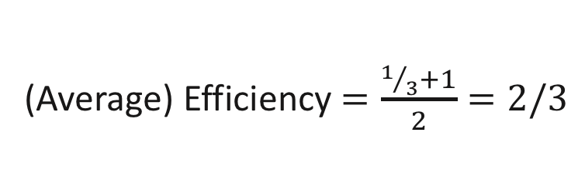
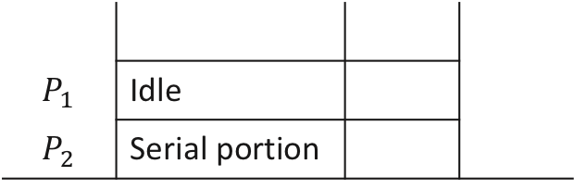
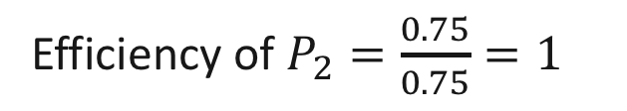

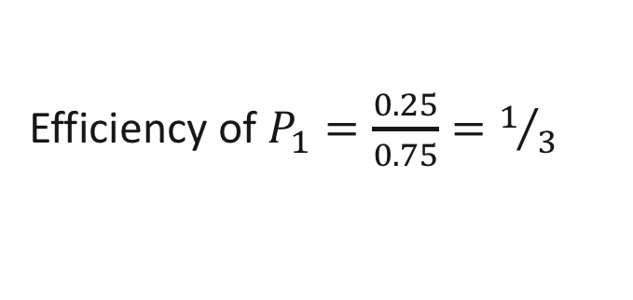
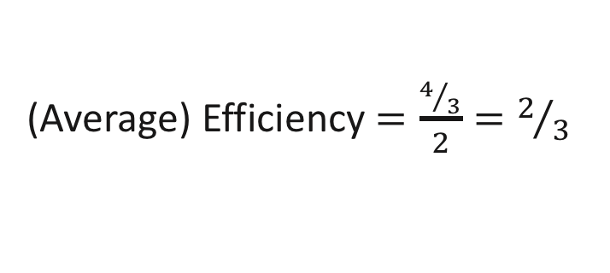
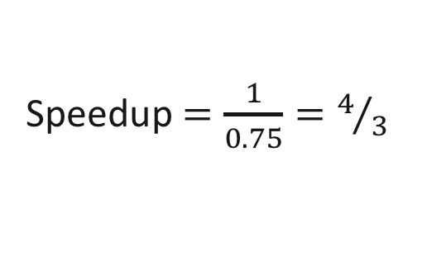
Performance (2)
$$S=0.5$$
$$P=0.5$$
Ex.
2 processor system
Speedup $=\frac{1}{0.75}=4/3$
Parallelized portion
(Ideal case)
(Average) Efficiency $=\frac{4/3}{2}=2/3$
$$P_{1}$$ | Idle
$$P_{2}$$ | Serial portion
Efficiency of $P_{1}=\frac{0.25}{0.75}=1/3$
Efficiency of $P_{2}=\frac{0.75}{0.75}=1$
0.5
0.75
time
(Average) Efficiency $=\frac{1/3+1}{2}=2/3$

Slide 84
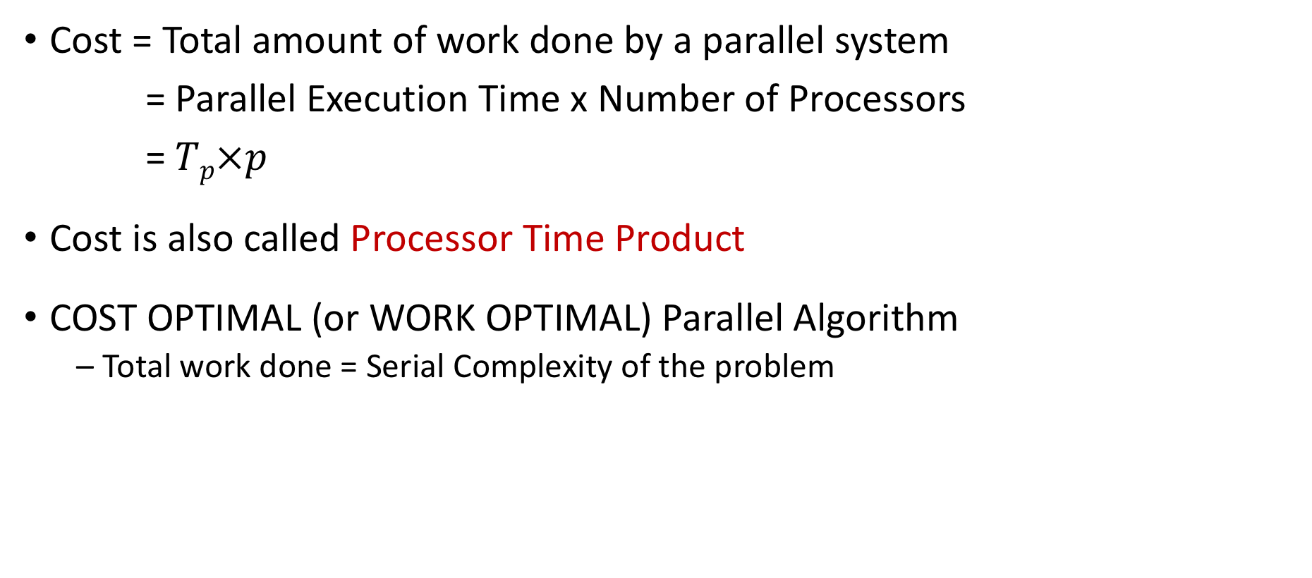
Performance (3)
Cost = Total amount of work done by a parallel system
= Parallel Execution Time x Number of Processors
= $Tp×p$
Cost is also called Processor Time Product
COST OPTIMAL (or WORK OPTIMAL) Parallel Algorithm
Total work done = Serial Complexity of the problem

Slide 85
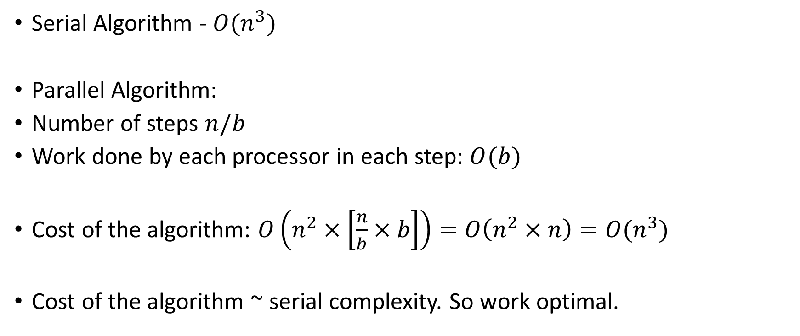
Blocked Matrix Multiplication
Serial Algorithm - $O(n^{3})$
Parallel Algorithm:
Number of steps $n/b$
Work done by each processor in each step: $O(b)$
Cost of the algorithm: $O\left(n^{2}×\left[\frac{n}{b}×b\right]\right)=O\left(n^{2}×n\right)=O(n^{3})$
Cost of the algorithm ~ serial complexity. So work optimal.
Total Number of Processors
Work done in each processor

Slide 86
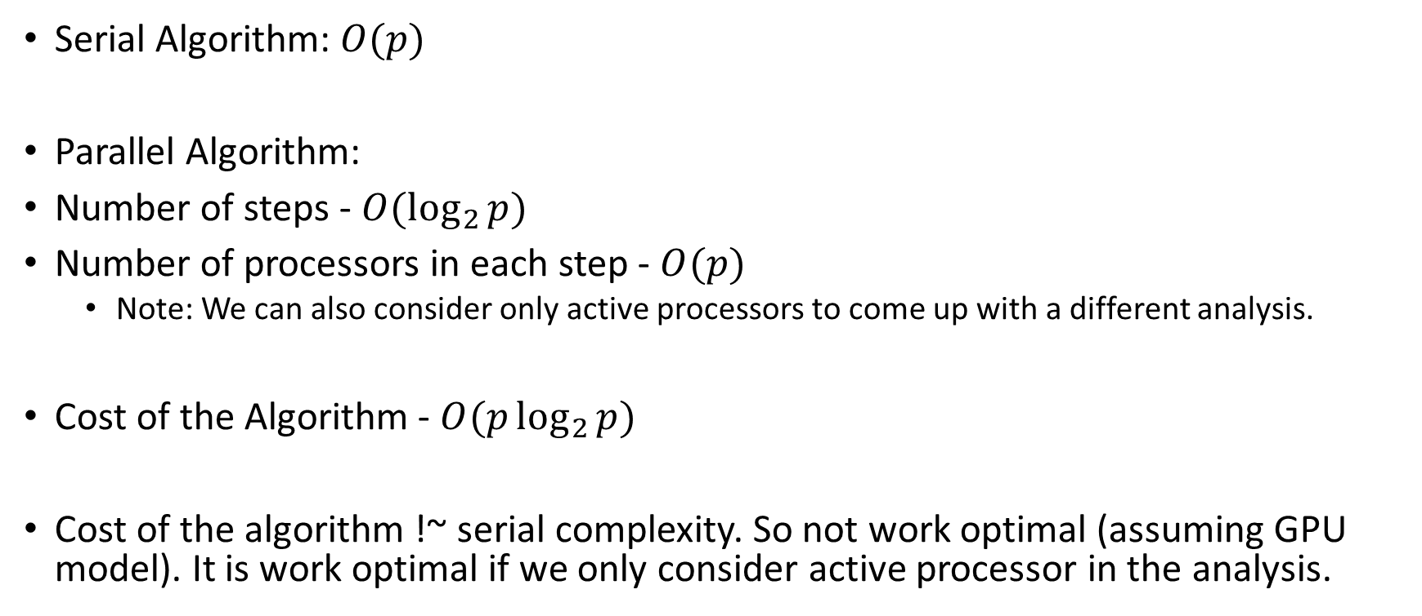
Sum of Elements in an Array
Serial Algorithm: $O(p)$
Parallel Algorithm:
Number of steps - $O(\log_{2}{p})$
Number of processors in each step - $O(p)$
Note: We can also consider only active processors to come up with a different analysis.
Cost of the Algorithm - $O(p\log_{2}{p})$
Cost of the algorithm !~ serial complexity. So not work optimal (assuming GPU model). It is work optimal if we only consider active processor in the analysis.

Slide 87
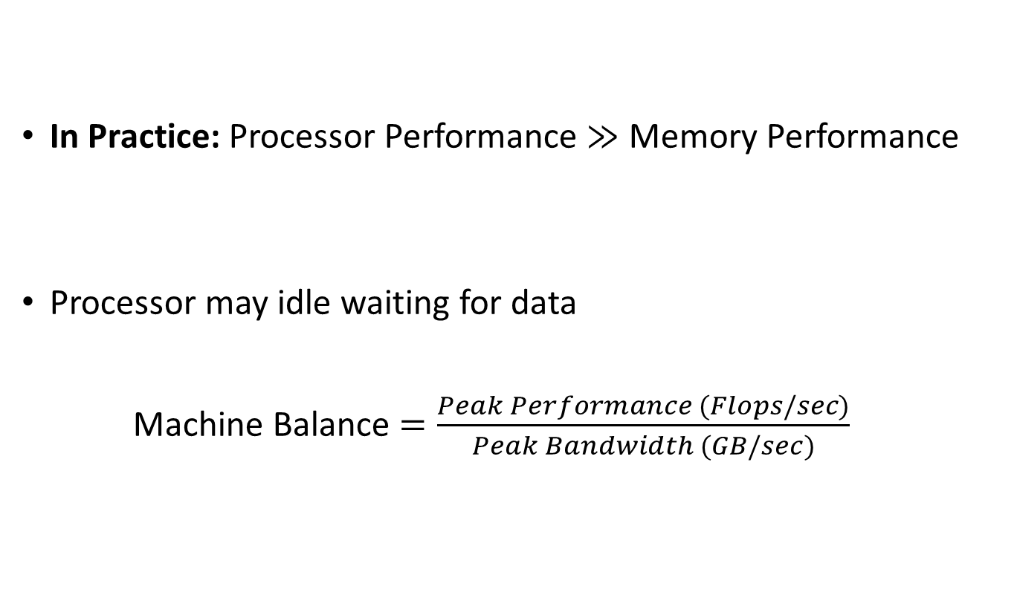
Roofline Model
In Practice: Processor Performance $≫$ Memory Performance
Processor may idle waiting for data
Machine Balance $=\frac{Peak Performance (Flops/sec)}{Peak Bandwidth (GB/sec)}$
M
# of data transferred/sec
Peak bandwidth
GB/sec
P
# of ops/sec
Peak Performance
# of floating point ops/sec
The Roofline Model
Samuel Williams, Lawrence Berkeley National Lab
https://escholarship.org/content/qt0qs3s709/qt0qs3s709.pdf

Slide 88

Roofline Model
Arithmetic Intensity (AI) $=$ For every fetched data (from memory) how many ops make use of them
$=\frac{\# of ops performed}{Amount of data moved from external memory}$
Algorithm Dependent
Example
AI of vector inner product $=\frac{2n}{2n}=O(1)$
AI of Dense matrix multiplication $=\frac{2n^{3}}{2n^{2}}=O(n)$

Slide 89
Roofline Model
Understand system bottlenecks – Computation vs Memory
High level model using few parameters (ignores ISA etc.)
Can be used to understand and evaluate an application performance on a target
Can be used to make architectural decisions for custom accelerators
The Roofline Model
Samuel Williams, Lawrence Berkeley National Lab
https://escholarship.org/content/qt0qs3s709/qt0qs3s709.pdf

Slide 90
Compute Bound vs Memory Bound Roofline Model (for a given platform)
Machine
Balance
Memory Bound
Compute Bound
Peak
Performance
Sustained Performance
(ops/sec)
log-log plot
1
10
0.1
Arithmetic Intensity

Slide 91
Compute Bound vs Memory Bound Roofline Model (for a given platform)
Machine
Balance
Memory Bound
Compute Bound
Peak
Performance
Sustained Performance
(ops/sec)
log-log plot
1
10
0.1
Arithmetic Intensity
Bold Red line denotes the maximum achievable performance for a given arithmetic intensity
Memory bound region: maximum achievable performance bounded by memory bandwidth
Compute bound region: maximum achievable performance bounded by compute capability

Slide 92
Compute Bound vs Memory Bound Roofline Model (for a given platform)
Compute Bound: Maximum Performance is limited by available compute resources
if we add more compute resources, the performance may improve (for a given bandwidth)
Useful in designing accelerators. Not a focus of this class
Memory Bound: Maximum Performance is limited by memory bandwidth
Reorder computations to more efficiently utilize bandwidth
In other words, improve arithmetic intensity to move right on x axis, which also improves y axis

Slide 93
Roofline Model – What about actual performance?
Machine
Balance
Memory Bound
Compute Bound
Peak
Performance
Sustained Performance
(ops/sec)
log-log plot
1
10
0.1
Arithmetic Intensity
For a fixed AI: improving performance (going up) requires better parallelism – Data and Task Parallel Techniques
Once the Red bold line is reached
Green Region: Write better algorithm to improve arithmetic intensity
Yellow Region: No algorithmic solution, need to add more computation power

Slide 94
WA 1
You should be able to answer all questions except the sorting one. We will discuss parallel sort in the next class

Slide 95
Next Class
9/16 Lecture 7 – Parallel Sorting; Task Parallelism

Slide 96
Thank You
Questions?
Email: sanmukh.kuppannagari@case.edu

